Slide 1
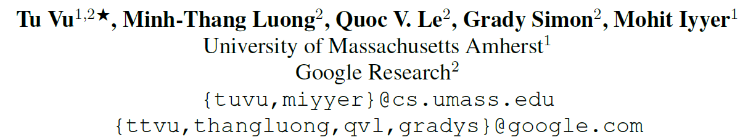
[EMNLP21] STraTA: Self-Training with Task Augmentation for Better Few-shot Learning
1
Notes:
无监督+元学习，无监督的目标就是学到一个比较好的表示可以在下游任务上表现出色

Slide 2
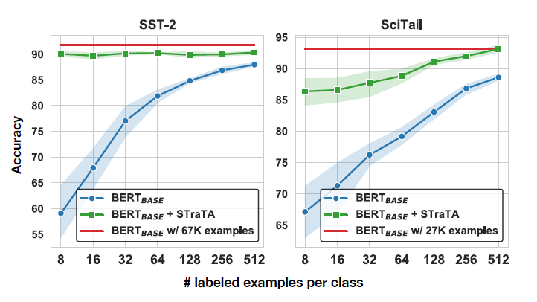
Motivation
2
Notes:
需要在大模型上进行微调训练才能达到不错的性能

Slide 3
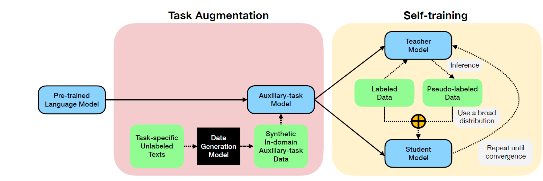
Approach
3

Slide 4
Task augmentation
Auxiliary task：NLI
pre-trained T5-3B MNLI
(sentA; sentB)→label
(label;sentA) → sentB
NLI classifier to filter examples
fine-tuning :MNLI + task augmentation dataset
4
Notes:
Nli:an effective auxiliary task+数据集比较多

Slide 5
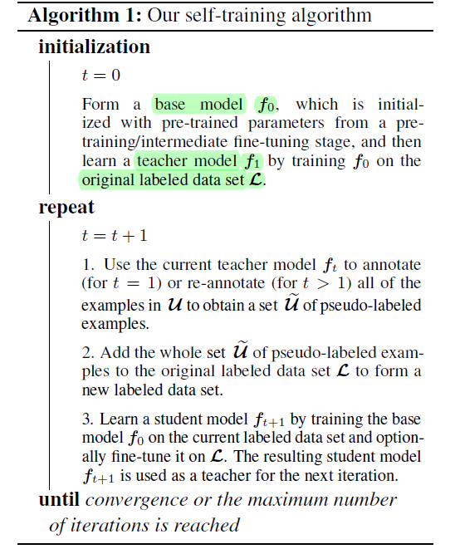
Self training
5
Notes:
Base model一直是f0，每一步迭代的是teacher model

Slide 6
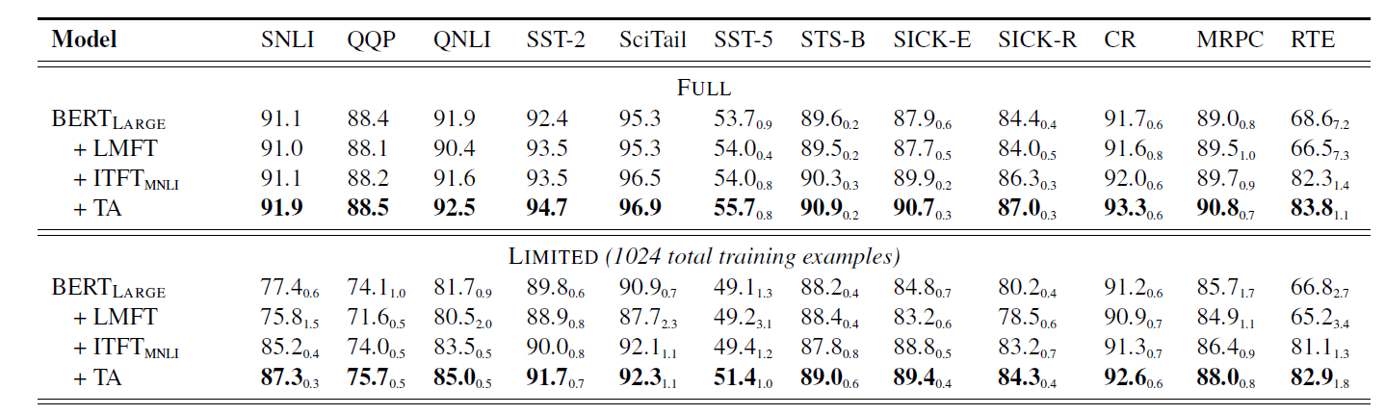
Experiment
LMFT: task specific unlabeled data +target task
ITFT: MNLI+ target task
Task augmentation (TA) and self-training (ST)
6
Notes:
对比不同meta learning的方法
这个数据集上ACAI embedding的方法不错

Slide 7
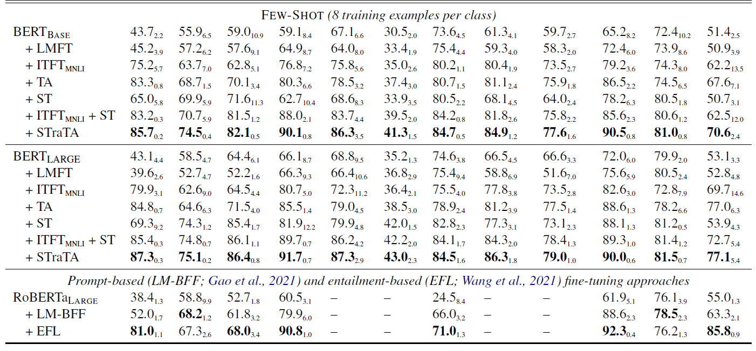
Experiment
7
Notes:
对比不同meta learning的方法
这个数据集上ACAI embedding的方法不错

Slide 8
Experiment
Task augmentation significantly improves results on downstream tasks
Adding self-training further boosts downstream performance when task-specific unlabeled examples are available
Using a better base model leads to better self training results
8
Notes:
对比不同meta learning的方法
这个数据集上ACAI embedding的方法不错

Slide 9
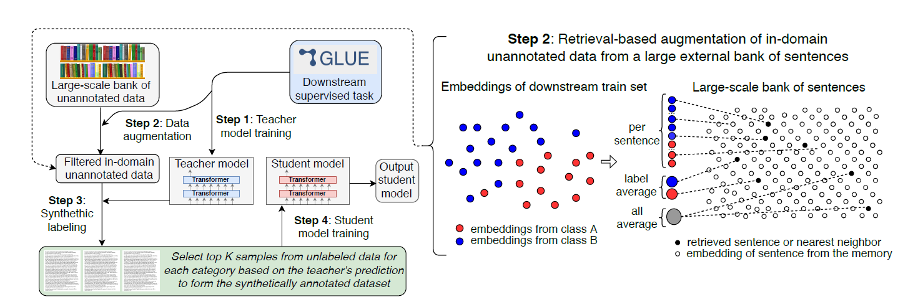
Experiment
[NAACL21]Self-training Improves Pre-training for Natural Language Understanding
9
Notes:
对比不同meta learning的方法
这个数据集上ACAI embedding的方法不错

Slide 10
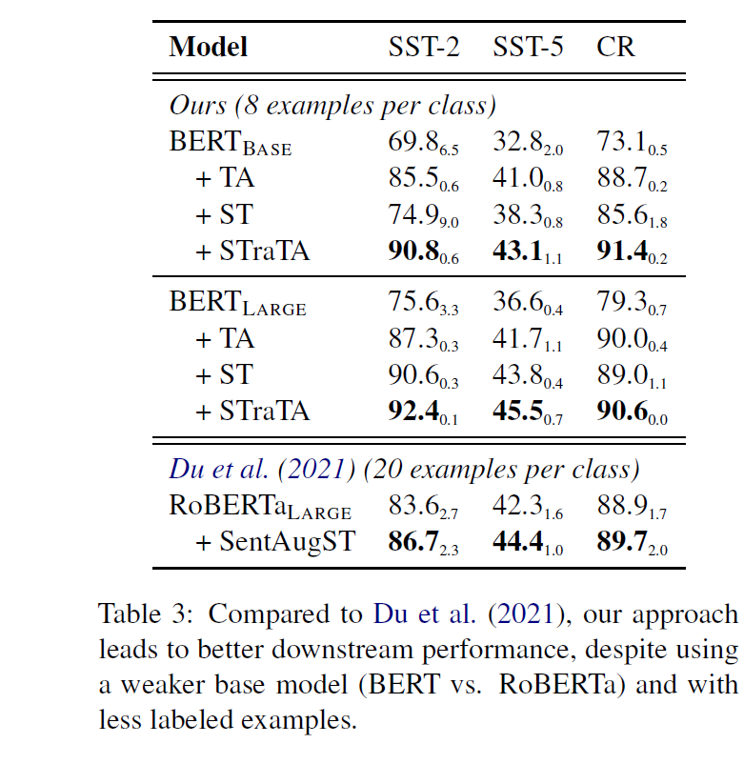
Experiment
Retrieves “in-domain” data
Using task-specific labeled trained data base model
Base model → pseudo-labels
pseudo-labels + labeled trained data → base model
10
Notes:
对比不同meta learning的方法
这个数据集上ACAI embedding的方法不错

Slide 11
Sample efficiency
11
Notes:
需要在大模型上进行微调训练才能达到不错的性能

Slide 12
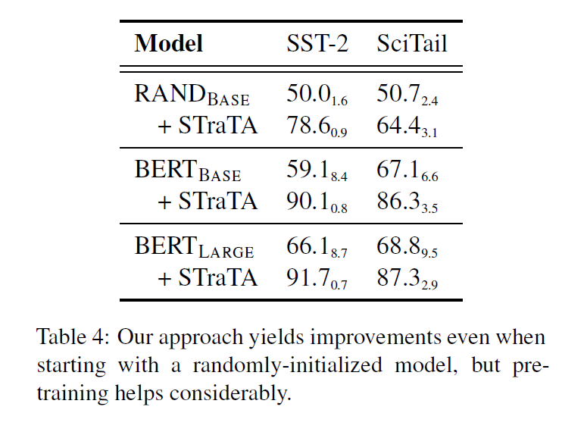
Experiment
STraTA improves a randomly-initialized basemodel
12
Notes:
对比不同meta learning的方法
这个数据集上ACAI embedding的方法不错

Slide 13
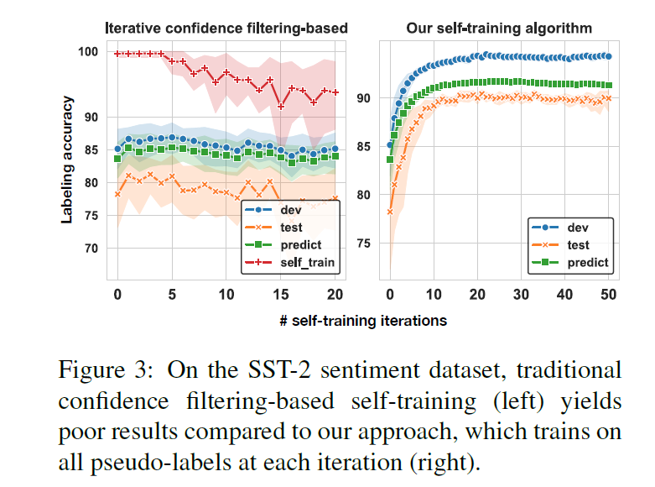
Traditional self-training
13
Notes:
左图红色的线是筛选出来的置信度高的32歌样本在迭代次数中的准确率，然后一旦添加就不会删掉

Slide 14
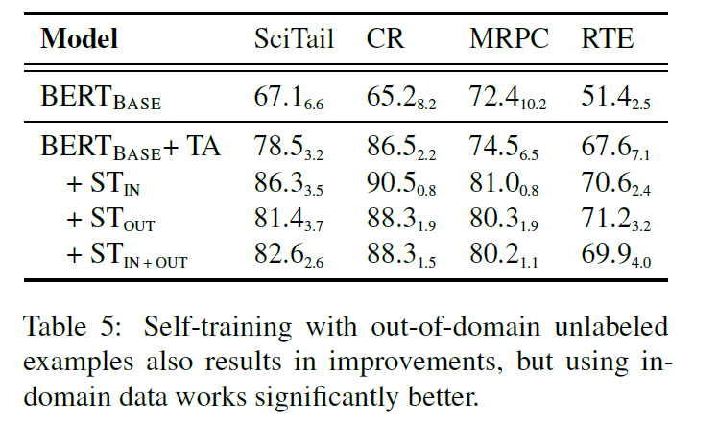
out-of-domain
14
Notes:
左图红色的线是筛选出来的置信度高的32歌样本在迭代次数中的准确率，然后一旦添加就不会删掉

Slide 15
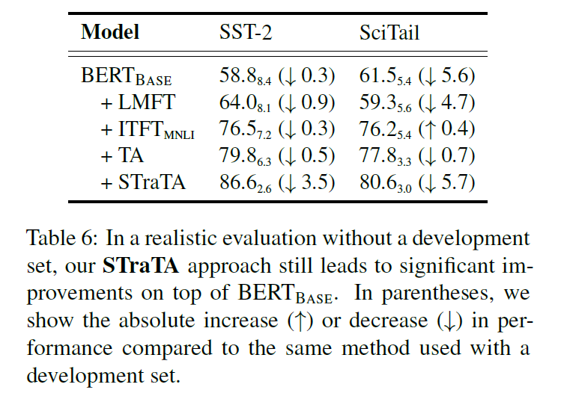
Realistic evaluation
15
Notes:
左图红色的线是筛选出来的置信度高的32歌样本在迭代次数中的准确率，然后一旦添加就不会删掉

Slide 16
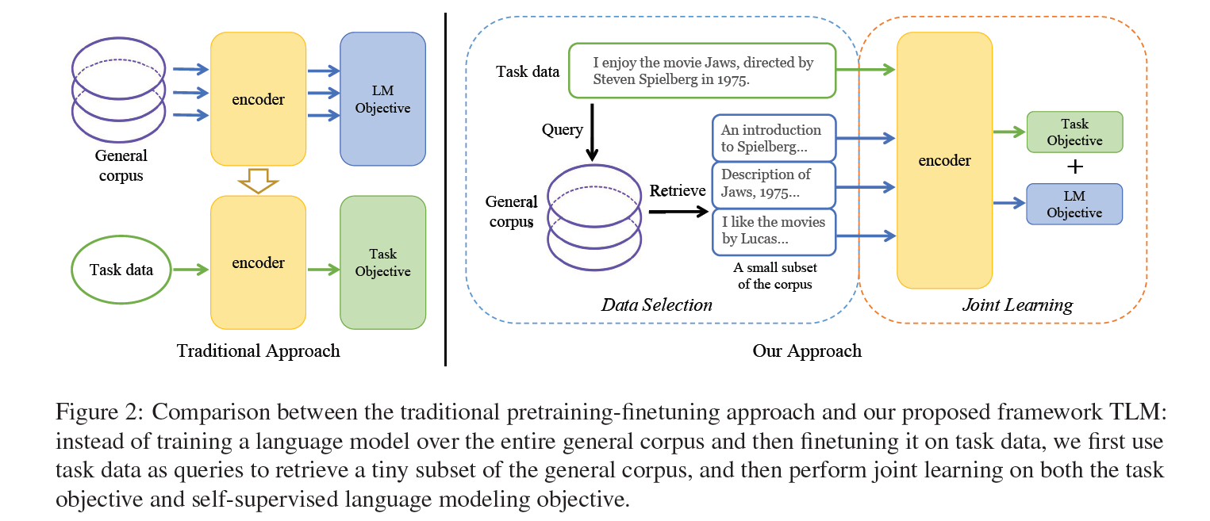
Experiment
NLP From ScratchWithout Large-Scale Pretraining: A Simple and Efficient Framework
16
Notes:
对比不同meta learning的方法
这个数据集上ACAI embedding的方法不错

Slide 17
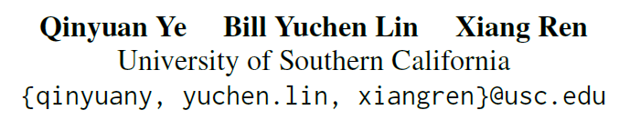
[EMNLP21]CROSSFIT : A Few-shot Learning Challenge for Cross-task Generalization in NLP
17
Notes:
作者单位
根据explanation来进行关系分类

Slide 18
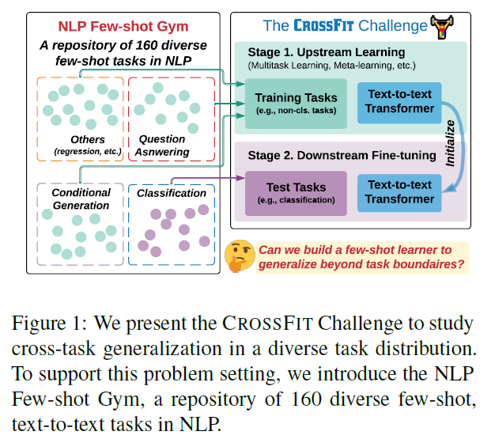
CrossFit Challenge
Instance-level generalization
one individual task
better few-shot fine-tuning
Task-level generalization
18

Slide 19
CrossFit Challenge
Q1. Can we teach cross-task generalization ability to pre-trained models with existing methods?
Q2. Well-rounded or Specialized and targeted
Q3. Does it help if we have more labelled data for seen tasks during upstream learning?
19

Slide 20
Conclusion
Simple multi-task learning outperforms existing meta-learning methods in many cases
Performance of unseen tasks varies with different selection of seen tasks
Enlarging the size of upstream data does not necessitate better cross-task generalization abilities.
20

Slide 21
Problem Setting
Learning Stages
Upstream learning stage(train+dev)
Few-shot learning stage(test)
Evaluation Metric
Average Relative Gain (ARG):relative performance changes before and after the upstream learning stage for each test task
160 few shot tasks: Unified Text-to-Text Format
Train: 16 or 32 per class, dev same size, different random seed
21

Slide 22
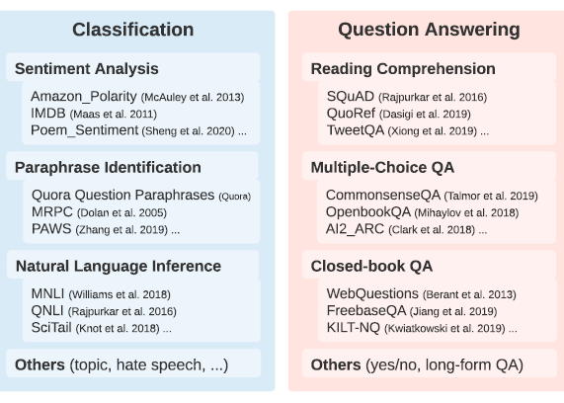
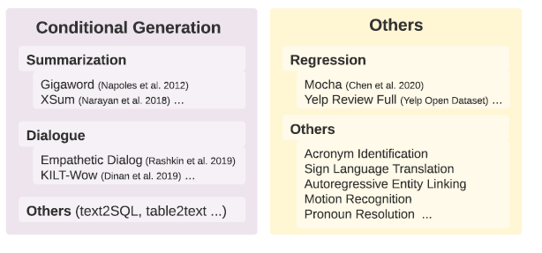
Task Partitions
22

Slide 23
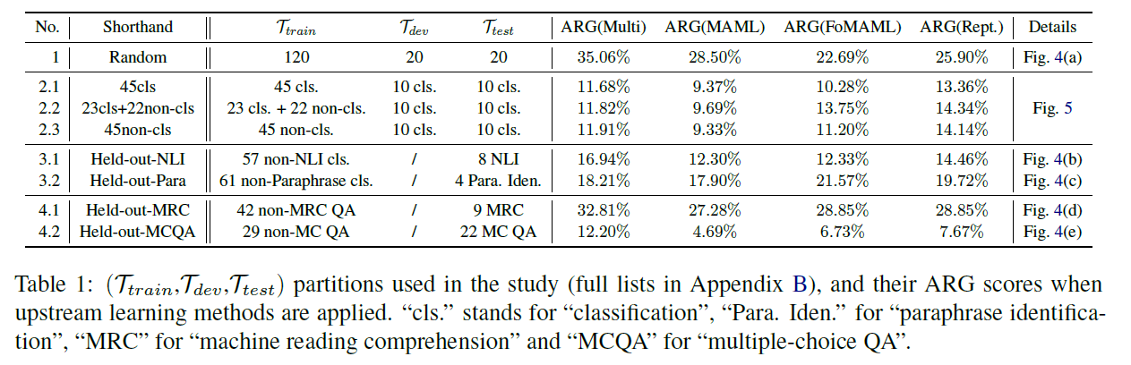
Task Partitions
23

Slide 24
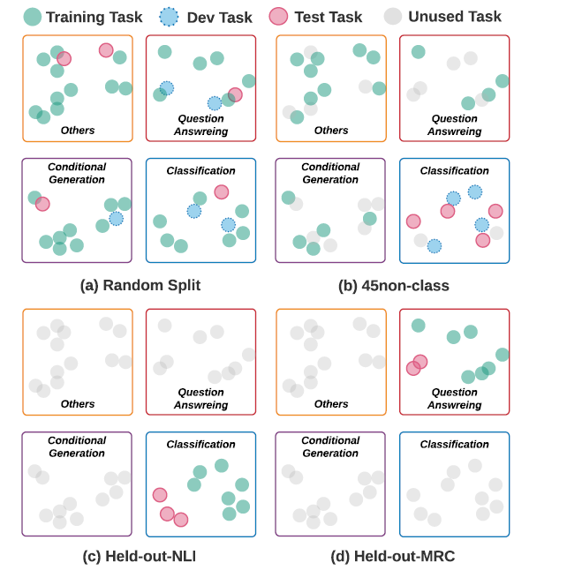
Task Partitions
understand the influence
brought by different task distribution in train
Understand whether cross-task generalization in this finer granularity is easier for model to acquire.
24

Slide 25
Models
Direct Fine-tuning on Test Tasks.(fine-tune on train)
Multi-task Learning (MTL).
Model-Agnostic Meta-learning (MAML).
First-order MAML
Reptile
25

Slide 26
Task Partitions
MTL is a strong baseline
26
Notes:
upstream learning methods indeed improve cross-task generalization:
不同的上游学习方法所获得的性能增益是相互关联的

Slide 27
Task Partitions
MTL is a strong baseline：
Limit the number of inner loop updates
Complex architectures
Under-explored difficulties
27

Slide 28
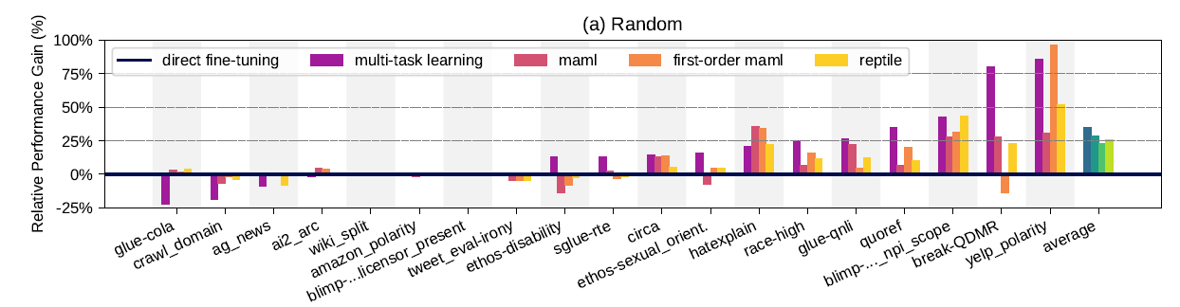
Task Partitions
Forgetting Pre-Trained Knowledge
28

Slide 29
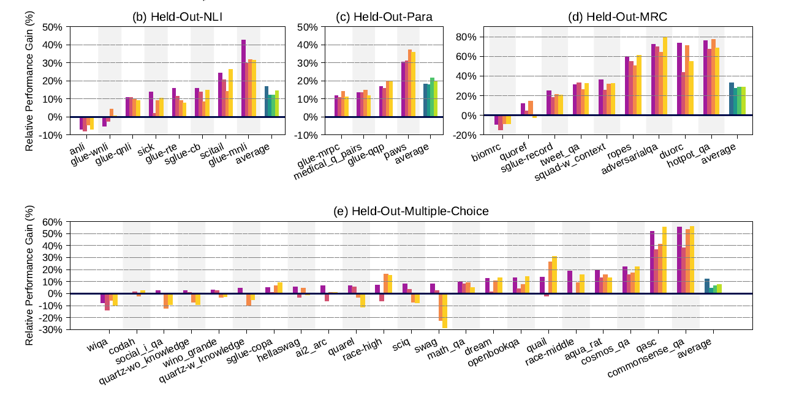
Task Partitions
29

Slide 30
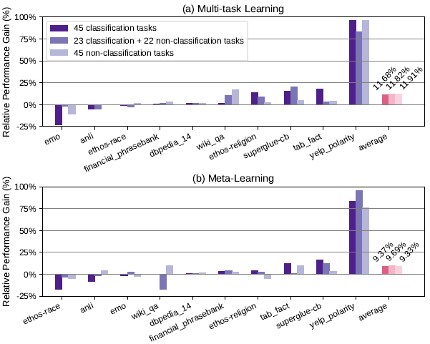
Well-rounded or specialized
30
Notes:
非分类任务和分类任务在ARG得分方面的帮助相当
选择与测试任务具有相同格式和目标的train任务可能不会导致最优迁移

Slide 31
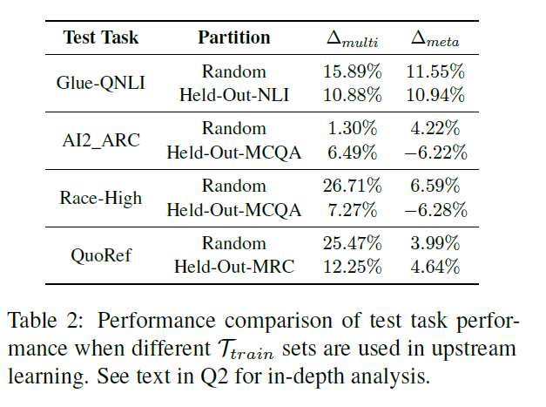
Well-rounded or specialized
A test task of multiple partitions
31

Slide 32
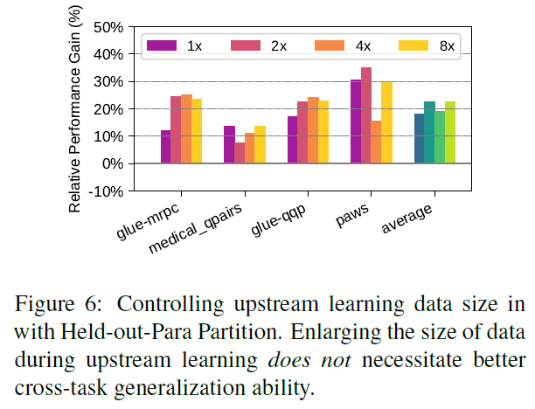
more labelled data?
32

Slide 33
More finding
Few-Shot → More-Shot : performance grows with shots
Using Different Base Models: performance grows with models sizes
Integration with PET Training : deteriorated performance
33

Slide 34
Conclusion
the selection of seen tasks would influence the few-shot performance on unseen tasks.
generate prompt for diverse task formats
select appropriate source tasks to learn
apply task augmentation strategies to prevent over-fitting
accumulate knowledge and avoid catastrophic forgetting
34

Slide 35
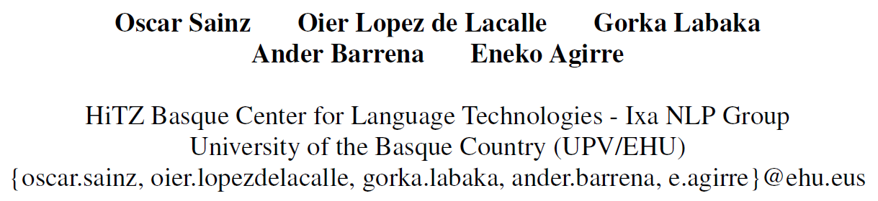
[EMNLP21] Label Verbalization and Entailment
for Effective Zero- and Few-Shot Relation Extraction
35
Notes:
作者单位
根据explanation来进行关系分类

Slide 36
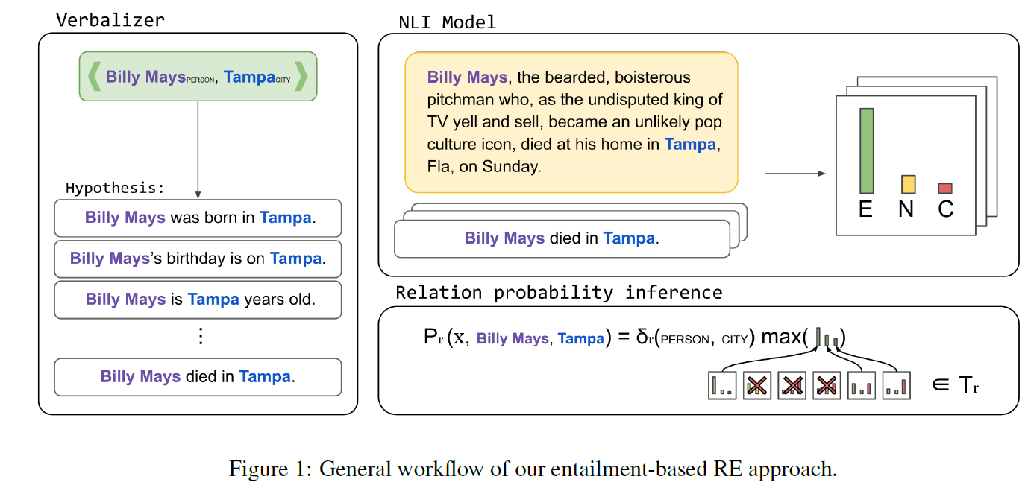
Approach
36
Notes:
将RE任务转换成一个NLI任务

Slide 37
Verbalizing relations as hypothesis
A relation label can be verbalized by one or more templates
A template can verbalize more than one relation label
Add the entity type information to each relation
PER:DATE_OF_BIRTH
PER: COUNTRY_OF_BIRTH
PER: City_OF_BIRTH
{subj}’s birthday is on {obj}.
{subj} was born on {obj}
{subj} was born in {obj}.
37

Slide 38
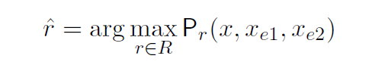
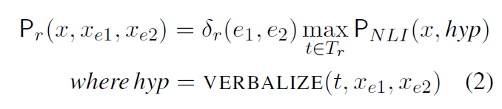
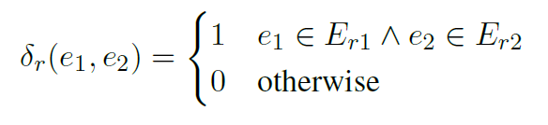
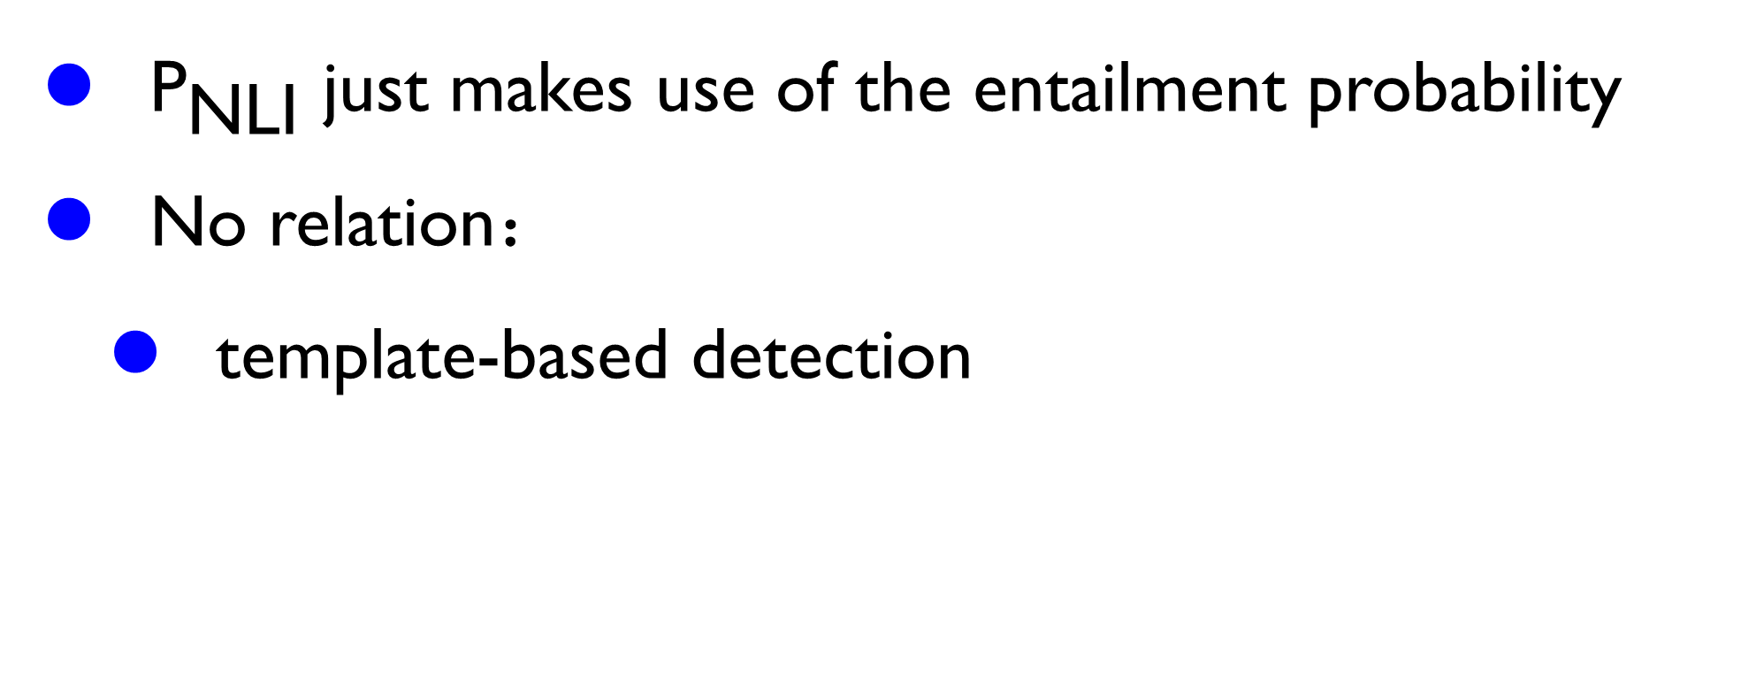
NLI for inferring relations
${\text{P}}_{\text{NLI}}$ just makes use of the entailment probability
No relation：
template-based detection
NO-RELATION
{subj} and {obj} are not related.
38

Slide 39
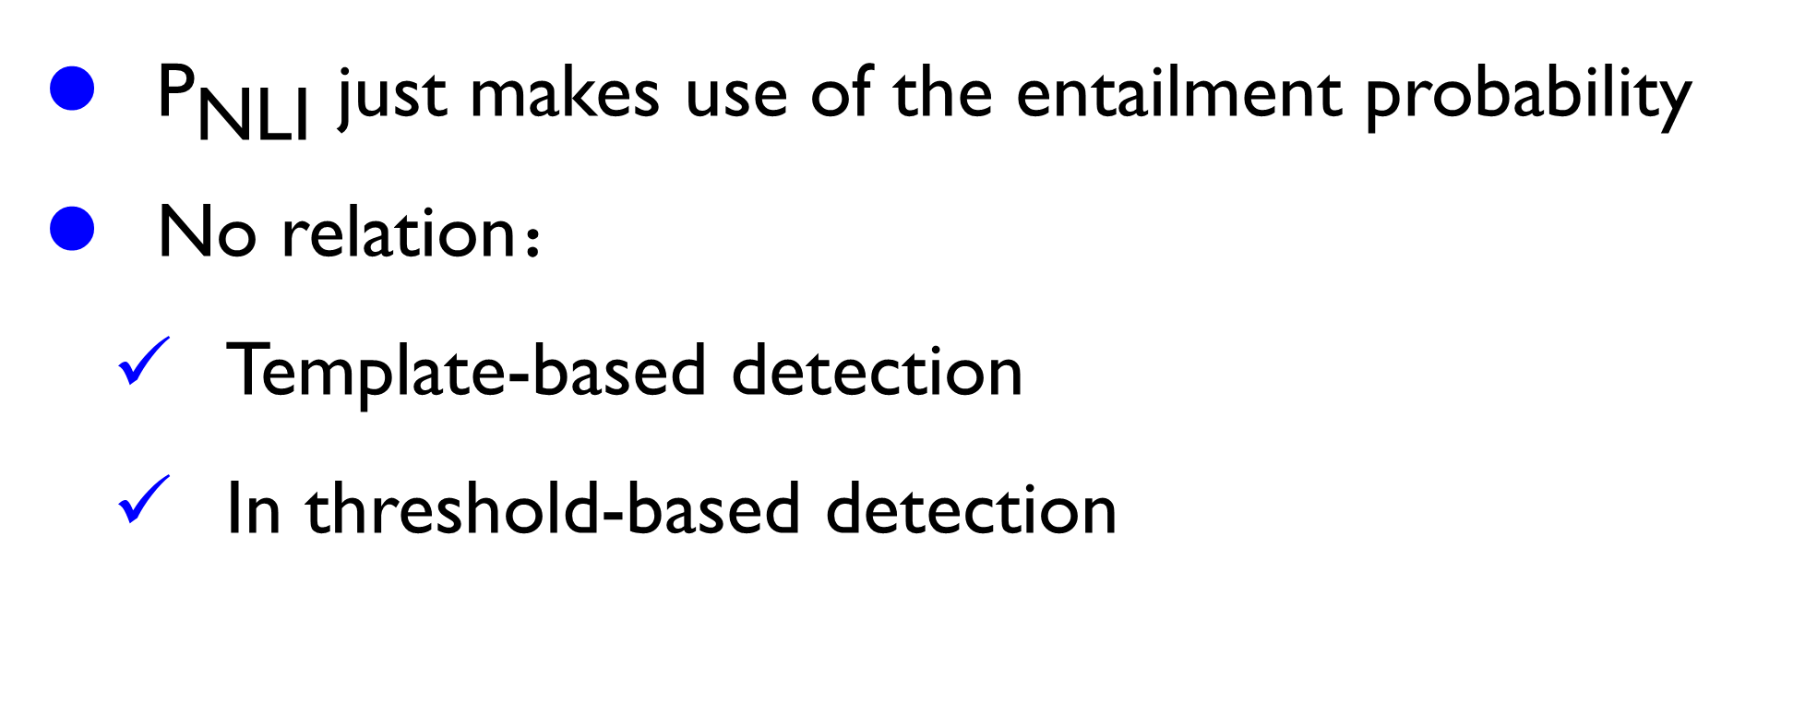
NLI for inferring relations
${\text{P}}_{\text{NLI}}$ just makes use of the entailment probability
No relation：
Template-based detection
In threshold-based detection
39

Slide 40
Approach
40
Notes:
将RE任务转换成一个NLI任务

Slide 41
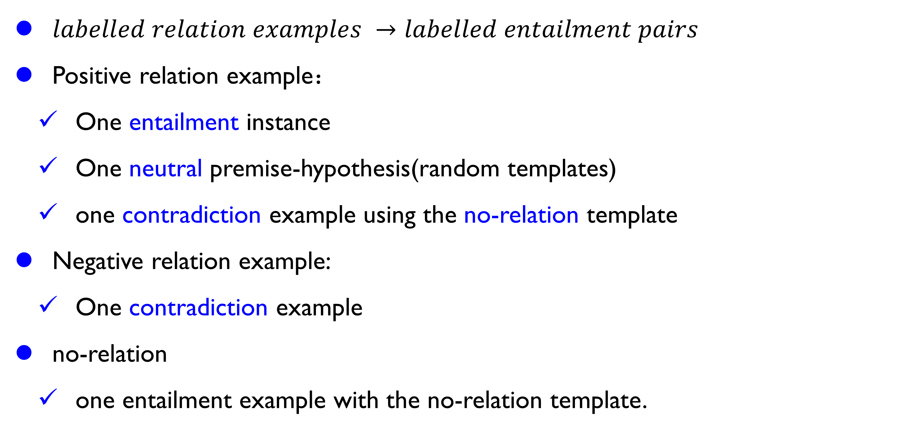
Few-Shot relation extraction
$labelled relation examples →labelled entailment pairs$
Positive relation example：
One entailment instance
One neutral premise-hypothesis(random templates)
one contradiction example using the no-relation template
Negative relation example:
One contradiction example
no-relation
one entailment example with the no-relation template.
41

Slide 42
Dataset and scenarios
Zero shot:
no data is available for development(0% split)
2 examples per relation (1% split)
Few-Shot: 4(1%),16(5%),32(10%)
Full Training
Data Augmentation
Zero shot: 利用模型标注数据建立伪label，来训练
Few shot：在有标注数据上微调后，标注伪label，在这两份数据上微调
42

Slide 43
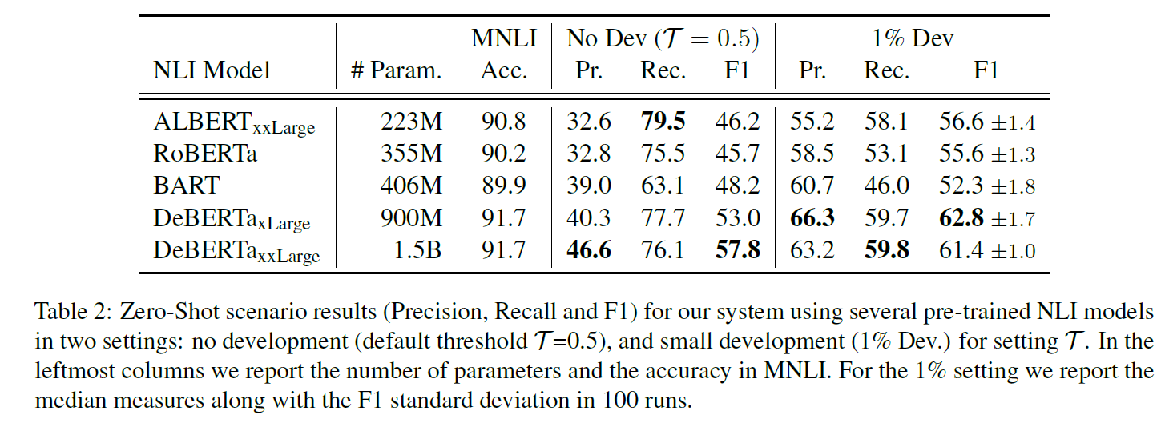
Experiment
In threshold-based detection
43

Slide 44
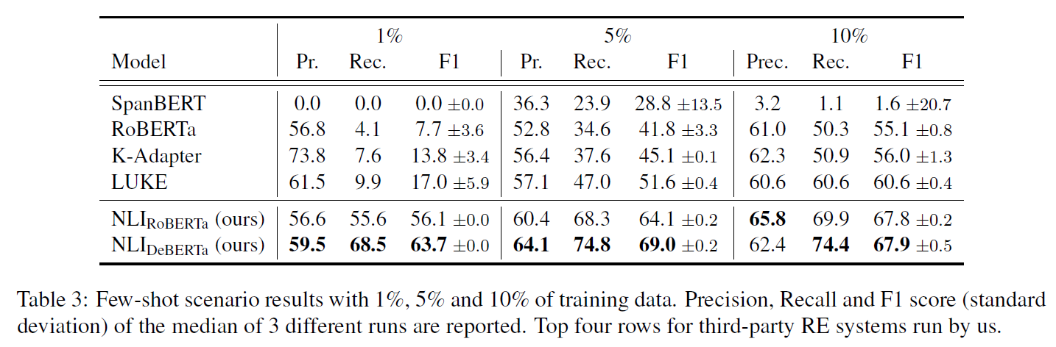
Experiment
44

Slide 45
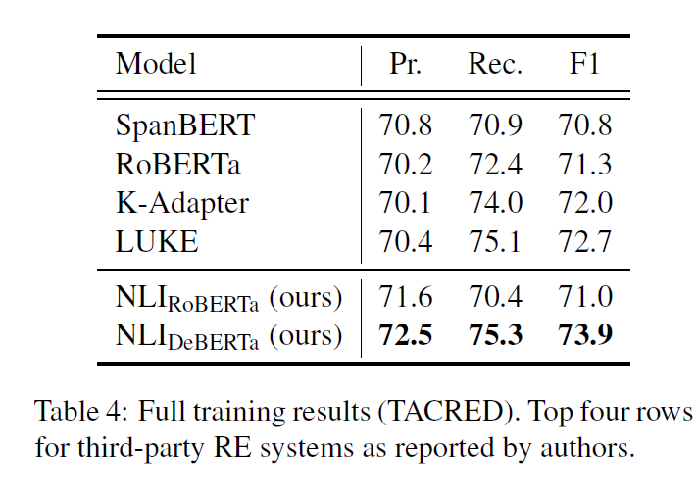
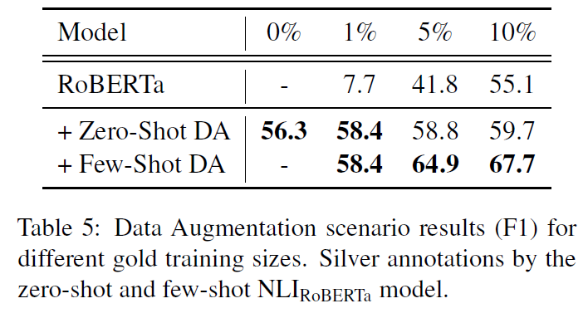
Full training
45

Slide 46
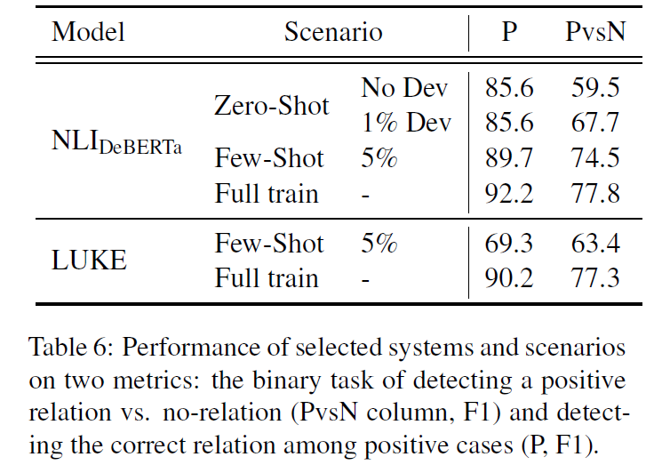
Analysis
P：without no relation
PvsN：no relation
46

Slide 47
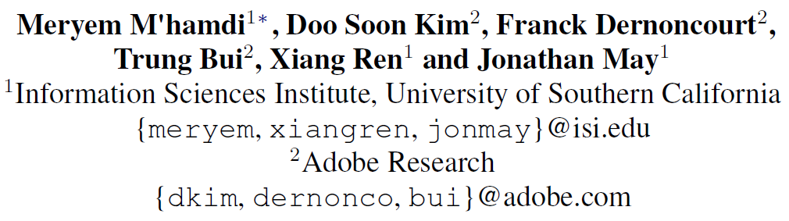
[ NAACL21] X-METRA-ADA: Cross-lingual Meta-Transfer Learning Adaptation to Natural Language
Understanding and Question Answering
47
Notes:
一大堆实验没啥有意思的结论

Slide 48
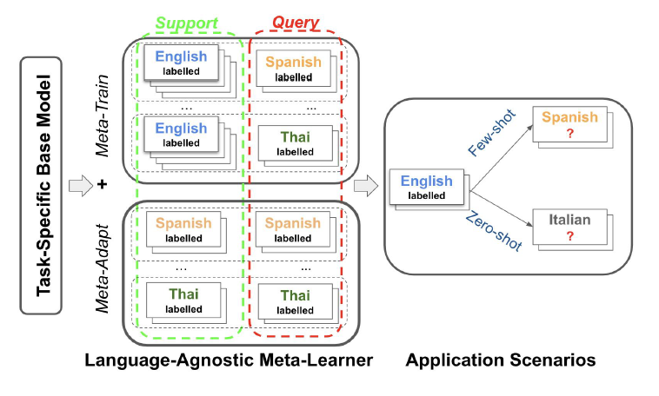
Overview
48
Notes:
单句分类任务也缺乏
跨句推理能力，导致
涉及句子对的下游任
务在训练测试中出现
严重的错配。

Slide 49
Contribution
Proposing X-METRA-ADA
Applying X-METRA-ADA to two challenging cross-lingual task
Analyzing the importance of different components in cross-lingual transfer
49
Notes:
单句分类任务也缺乏
跨句推理能力，导致
涉及句子对的下游任
务在训练测试中出现
严重的错配。

Slide 50
Internal Evaluation
PRE: fine-tuned on the Train split of English only
MONO: fine-tuned on the Dev split of the target language.
FT: PRE+MONO(transfer)
FT w/EN: fine-tuned PRE on the Train + Dev
X-METRA: PRE + meta train(support: EN, query: target)
X-METRA-ADA: meta train + meta test
50

Slide 51
External Baselines
Cross-lingual alignment-based approaches
Mixed-language training approaches
Translation-based approaches
51

Slide 52
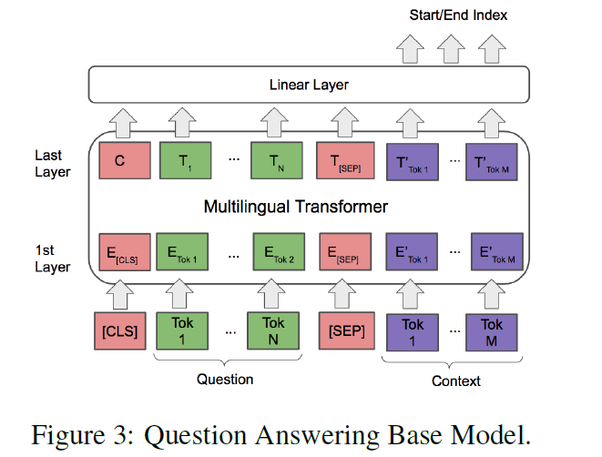
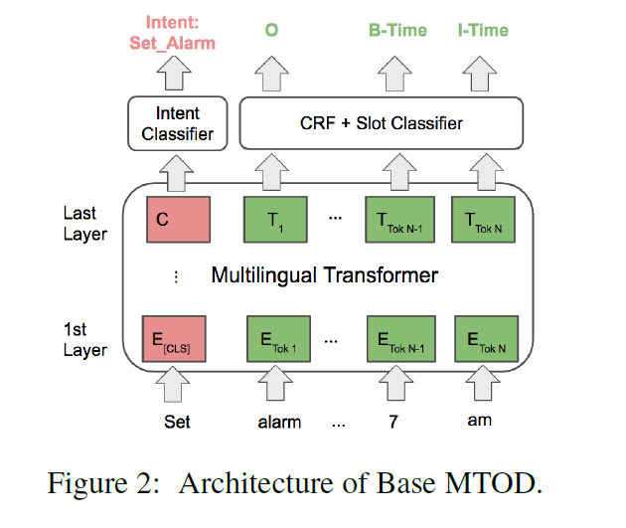
Task
52
Notes:
单句分类任务也缺乏
跨句推理能力，导致
涉及句子对的下游任
务在训练测试中出现
严重的错配。

Slide 53
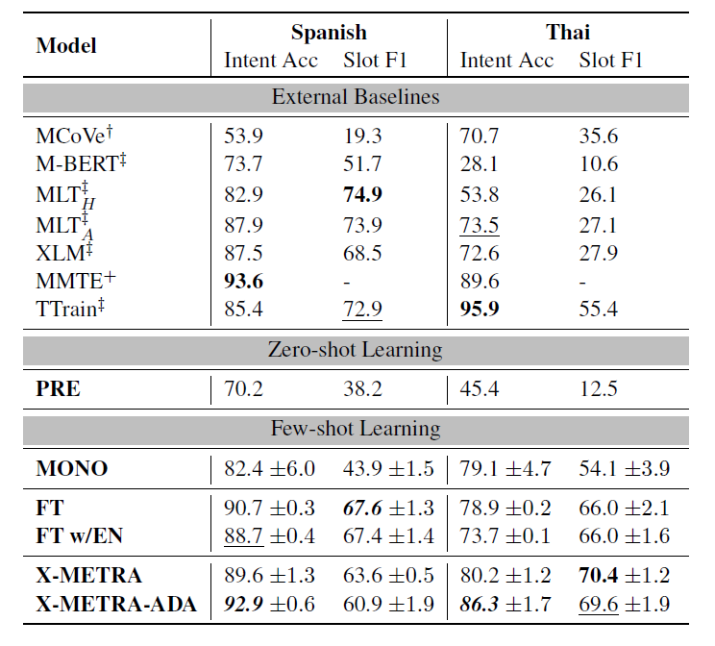
MTOD
Table 1:All our internal experiments use k = q = 6. Zero-shot learning experiments that train only on English are distinguished from few-shot learning, which include a fair internal comparison. MONO, FT, FT w/EN, X-METRA, and X-METRAADA models include results for each test language when training on that language. FT w/EN trains jointly on English and only the target language. We highlight the best scores in bold and underline the second best for each language and sub-task.
53
Notes:
一些分析：
1、PRE模型最差，只在英语上进行零距离微调M-BERT是对英语及其类似语言的过度适应。MLTA增加了更多针对对话的混合训练，这主要有助于减少泰语在意图准确性方面的差距，但在槽沟填充方面却没有达到同样的程度。
2. 在微调中添加英文数据略微有害

Slide 54
MTOD
Table 1:All our internal experiments use k = q = 6. Zero-shot learning experiments that train only on English are distinguished from few-shot learning, which include a fair internal comparison. MONO, FT, FT w/EN, X-METRA, and X-METRAADA models include results for each test language when training on that language. FT w/EN trains jointly on English and only the target language. We highlight the best scores in bold and underline the second best for each language and sub-task.
54
Notes:
一些分析：
1、PRE模型最差，只在英语上进行零距离微调M-BERT是对英语及其类似语言的过度适应。MLTA增加了更多针对对话的混合训练，这主要有助于减少泰语在意图准确性方面的差距，但在槽沟填充方面却没有达到同样的程度。
2. 在微调中添加英文数据略微有害
3. Meta learning most efficitive
MONO不稳定
ADA 在泰语上表现更好，因为真正的少样本
pre-trainingon English only learns an unsuitable initialization

Slide 55
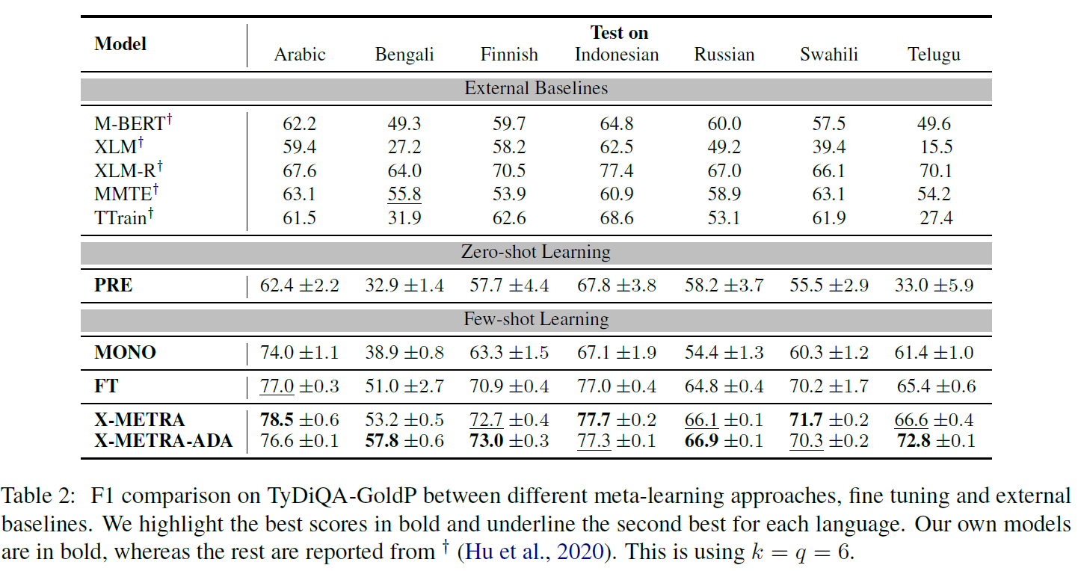
QA
55
Notes:
单句分类任务也缺乏
跨句推理能力，导致
涉及句子对的下游任
务在训练测试中出现
严重的错配。

Slide 56
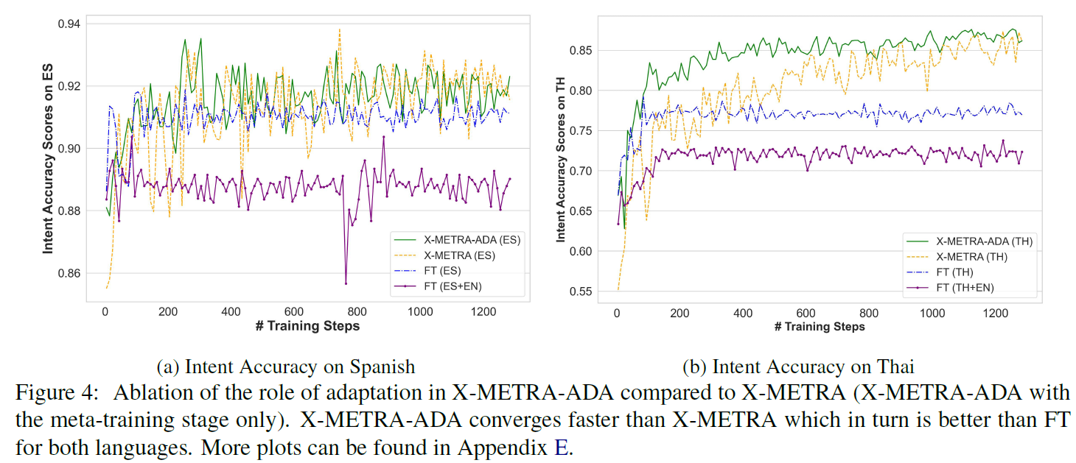
MTOD
56
Notes:
对于意大利于FT要更好variants of meta-learning for Slot filling on Spanish，因为意大利语和英文比较像

Slide 57
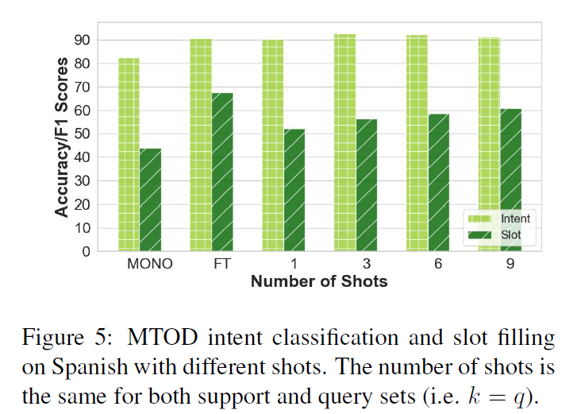
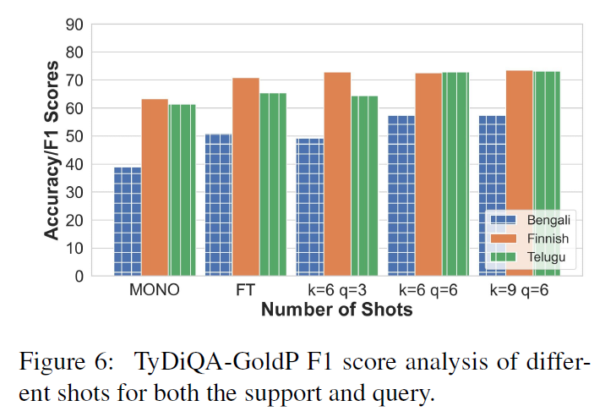
K-Shot Analysis
57
Notes:
对于意大利于FT要更好variants of meta-learning for Slot filling on Spanish，因为意大利语和英文比较像

Slide 58
Conclustion
Proposing X-METRA-ADA
Applying X-METRA-ADA to two challenging cross-lingual task
Analyzing the importance of different components in cross-lingual transfer
58
Notes:
单句分类任务也缺乏
跨句推理能力，导致
涉及句子对的下游任
务在训练测试中出现
严重的错配。

Slide 59
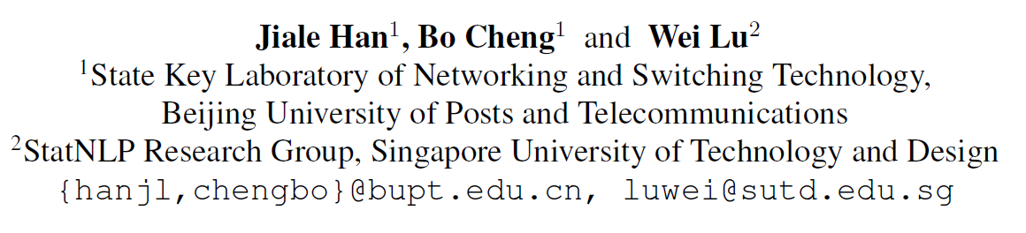
Exploring Task Difficulty for Few-Shot Relation Extraction
59
Notes:
作者单位
根据explanation来进行关系分类

Slide 60
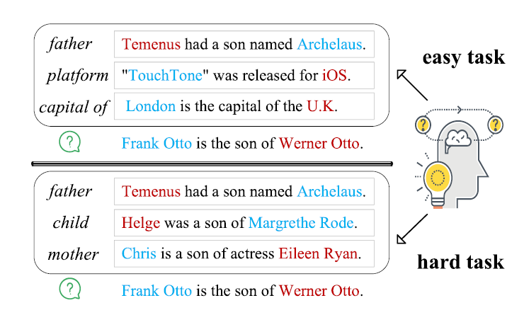
Motivation
60

Slide 61
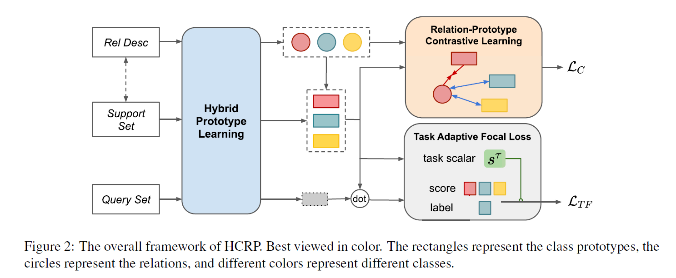
Approach
61

Slide 62
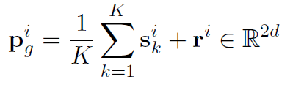
Hybrid Prototype Learning
Global Prototypes
Two entity representation+relation
62
Notes:
介绍data to text任务

Slide 63



Hybrid Prototype Learning
Local Prototypes
Allocate weights to different tokens according to their similarities with relation descriptions,
63
Notes:
介绍data to text任务

Slide 64



Contrastive Learning
Local Prototypes
Allocate weights to different tokens according to their similarities with relation descriptions,
64
Notes:
介绍data to text任务

Slide 65

Results
65
Notes:
介绍data to text任务

Slide 66

[EMNLP21] Diverse Distributions of Self-Supervised Tasks for Meta-Learning in NLP
66
Notes:
无监督+元学习，无监督的目标就是学到一个比较好的表示可以在下游任务上表现出色

Slide 67

SMLMT
Overly simplistic
Uniform sampling (task distribution)
Single-sentence classification
67
Notes:
单句分类任务也缺乏
跨句推理能力，导致
涉及句子对的下游任
务在训练测试中出现
严重的错配。

Slide 68
Sampling labels in SMLMT
Frequency-based sampling
Cluster-based sampling
the same cluster (intra-cluster sampling)→difficult task
different clusters (inter-cluster sampling)→easy task
68
Notes:
单句分类任务也缺乏
跨句推理能力，导致
涉及句子对的下游任
务在训练测试中出现
严重的错配。

Slide 69

Dynamic Curriculum
Frequency-based sampling
Cluster-based sampling
the same cluster (intra-cluster sampling)→difficult task
different clusters (inter-cluster sampling)→easy task
Dynamic Curriculum over Self-Supervised Tasks(an easy to-hard curriculum)
Contrastive learning over sentence pairs
69
Notes:
单句分类任务也缺乏
跨句推理能力，导致
涉及句子对的下游任
务在训练测试中出现
严重的错配。

Slide 70

Experiment
Frequency (FREQ)
Inter-Cluster(X-C)
Intra-Cluster (I-C)
Sentence Cluster (S-C)
70
Notes:
介绍data to text任务

